Slide 1
Behaviors Change Theories
EHS 215
IRIET NAMAJA CAROLYNE CUU

Slide 2
Behavioral change theories
Behavioral change theories attempt to explain why behavior changes.
These theories serve to understand better those factors associated with maximizing adherence to positive physical activity and lifestyle behaviors at the individual, community and population levels.
IRIET NAMAJA CAROLYNE CUU

Slide 3
Theories of behavior change
According to these theories behavior is determined by:
Environmental characteristics
Personal characteristics
Behavioral characteristics.
Understanding behavioral change will improve the services offered in these areas:
Health
Education
These theories have attracted growing attention as the negative consequences of unhealthy lifestyle behaviors have become increasingly apparent.
They are pertinent to the development of effective interventions in the field of health and physical activity
IRIET NAMAJA CAROLYNE CUU

Slide 4
Theories of behavior change
These theories are important because:
The negative consequences of unhealthy lifestyle behaviors have become increasingly apparent, and
There is a growing need for the development of effective interventions in the field of health and physical activity.
IRIET NAMAJA CAROLYNE CUU

Slide 5
General Theories & Models
Learning theories/ behavioural analytic theories of change
Social learning/ social cognitive theory
Theory of Reasoned Action
Theory of Planned Behaviour
Health Action Process approach
Transtheoretical theory/ Stages of Change Model
IRIET NAMAJA CAROLYNE CUU

Slide 6
The Key Elements of Behavior Change
Key Element Strategies for Behavior Change
------------------------------------------------------------------------------------------------------- Threat Raise awareness that the threat exists, focusing on severity and susceptibility.
------------------------------------------------------------------------------------------------------
Fear Fear can powerfully influence behavior and, if it is channeled in the appropriate way, can motivate people to seek information, but it can also cause people to deny they are at-risk.
------------------------------------------------------------------------------------------------------
Response Efficacy Provide evidence of examples that the recommended response will avert the threat
------------------------------------------------------------------------------------------------------
Self-Efficacy Raise individuals’ confidence that they can perform response and help ensure they can avert the threat.
IRIET NAMAJA CAROLYNE CUU

Slide 7
The Key Elements of Behavior Change
Key Element Strategies for Behavior Change
-------------------------------------------------------------------------
Barriers Be aware of physical or cultural barriers that might exist, attempt to remove barriers.
--------------------------------------------------------------------------------
Benefits Communicate the benefits of performing the recommended response.
---------------------------------------------------------------------------------
Subjective Norms Understand with whom individuals are
likely to comply.
-----------------------------------------------------------------------------------
Attitudes Measure existing attitudes before attempting to change them..
IRIET NAMAJA CAROLYNE CUU

Slide 8
The Key Elements of Behavior Change
Key Element Strategies for Behavior Change
------------------------------------------------------------------------------
Intentions Determine if intentions are genuine or proxies for actual behavior.
-------------------------------------------------------------------------------
Cues to Action Provide communication that might trigger individuals to make decisions.
-------------------------------------------------------------------------------
Reactance Ensure individuals do not feel they have been manipulated or are unable to avert the threat.
---------------------------------------------------------------------------------
IRIET NAMAJA CAROLYNE CUU

Slide 9
Self-efficacy
Self-efficacy is the belief in one's own ability to complete tasks and reach goals. such as facing an exam or undergoing surgery.
It is an important element of many of the theories, including:
the Health Belief Model,
the Theory of Planned Behaviour
the Health Action Process Approach.
IRIET NAMAJA CAROLYNE CUU

Slide 10
Self-efficacy
The individual impression is based on factors like:
  Individual’s prior success in tasks,
  Physiological state,
  Outside sources of persuasion.
Self-efficacy expectations have been found repeatedly to be important determinants of:
  The choice of activities in which people engage
  How much energy they will expend on such activities and
  The degree of persistence they demonstrate in the face of failure and/or adversity.
Self-efficacy means individual’s impression of their own ability to perform a demanding or challenging task such as facing an exam or undergoing surgery.
It is an important element of many of the theories, including: the Health Belief Model, the Theory of Planned Behaviour and the Health Action Process Approach.
The individual impression is based on factors like the individual’s prior success in the tasks,
IRIET NAMAJA CAROLYNE CUU

Slide 11
Learning theories/behavior analytic theories of change
State that complex behavior is learned gradually through modification of simpler behaviors
As each simple behavior is established through imitation and reinforcement, the complex behavior develops
IRIET NAMAJA CAROLYNE CUU

Slide 12
Social learning/ social cognitive theory
States that people learn within a social context.
It is facilitated through concepts such as modeling and observational learning.
People learn by observing others, with the environment, behavior, and cognition all as the chief factors in influencing development.
Models are an important source for learning new behaviors and for achieving behavioral change in institutionalized settings.
IRIET NAMAJA CAROLYNE CUU

Slide 13
Social learning/ social cognitive theory
States behavioural change is determined by:
  Environmental,
  Personal and
  Behavioral elements.
Each factor affects each of the others.
It focuses on the reciprocal interactions between the three factors, which are hypothesized to determine behavioural change.
IRIET NAMAJA CAROLYNE CUU

Slide 14
Theory of Reasoned Action
Assumes that individuals consider a behavior's consequences before performing the particular behavior.
As a result, intention is an important factor in determining behavior and behavioural change.
Intention is shaped by personal attitude and social pressure .
IRIET NAMAJA CAROLYNE CUU

Slide 15
Theory of Planned Behaviour
Represents an expansion upon the theory of reasoned action.
It states that behavior performance is proportional to the amount of control an individual possesses over the behavior and the strength of the individual's intention in performing the behavior.
Self-efficacy is important in determining the strength of the individual's intention to perform a behavior.
IRIET NAMAJA CAROLYNE CUU

Slide 16
Health Action Process approach
A psychological theory of health behavior change.
It refers to a replacement of health-compromising behaviors (such as sedentary behavior) by health-enhancing behaviors (such as physical exercise).
These theories explain and predict individual changes in health behaviors such as:
  Quitting smoking or drinking
  Improving physical activity levels
  Dental hygiene
  Seat belt use,
  Self breast examination,
  Dietary behaviors.
IRIET NAMAJA CAROLYNE CUU

Slide 17
Health Action Process approach
These theories are designed to examine a set of psychological constructs that jointly aim at explaining what motivates people to change and how they take preventive action.
These theories are viewed as a structured process including a motivation phase and a volition phase.
  The motivation phase describes the intention formation
  The volition phase refers to planning, and action
The model emphasizes the particular role of perceived self-efficacy at different stages of health behavior change.
IRIET NAMAJA CAROLYNE CUU

Slide 18
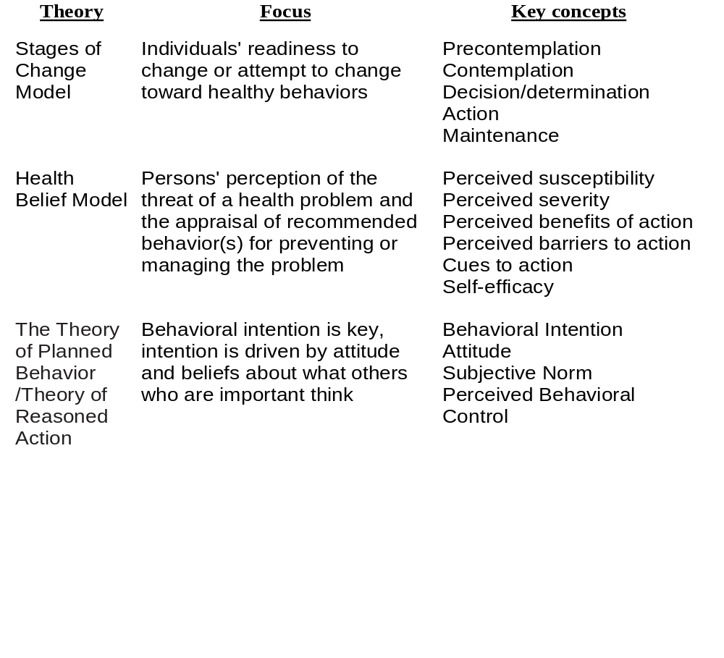
Individual Level

Slide 19
Stage Theories of Behaviour Change
These theories propose an integrated stage-based model.
According to these theories behavior change is viewed as a cyclical or spiral process that involves five stages of:
awareness of the problem and a need to change,
motivation to make a change,
skill development to prepare for the change,
initial adoption of the new activity or behavior, and
maintenance of the new activity and integration into the lifestyle.
IRIET NAMAJA CAROLYNE CUU

Slide 20
Stages of Change Model
(Transtheoretical Model)
The five stages, between which individuals may oscillate before achieving complete change, are:
  Precontemplation,
  Contemplation,
  Preparation,
  Action, and
  Maintenance.
IRIET NAMAJA CAROLYNE CUU

Slide 21
Stage Theories of Behaviour Change
Precontemplation:
In this stage, there is no intent on the part of the individual to change his or her behavior in the foreseeable future.
Contemplation:
People are aware that a problem exists and are seriously considering taking some action to address the problem.
IRIET NAMAJA CAROLYNE CUU

Slide 22
Stage Theories of Behaviour Change
Preparation:,
Involves both intention to change and some behavior, usually minor, and often meeting with limited success
Action:
Individuals actually modify their behavior, experiences, or environment in order to overcome their problems or to meet their goals.
Maintenance:
People work to prevent relapse and consolidate the gains attained in the action stage.
IRIET NAMAJA CAROLYNE CUU

Slide 23
Stage Theories of Behaviour Change
Behaviour change occurs in stages.
Movement through these stages is neither unitary or linear, but rather, cyclical, involving a pattern of :
- adoption ,
- maintenance,
- relapse, and
- readoption over time.
IRIET NAMAJA CAROLYNE CUU

Slide 24
Applications of Stage Theories of Behaviour Change
Health Care
Education
IRIET NAMAJA CAROLYNE CUU

Slide 25
Theories of Behaviour Change & Health Care
Behavioral change theories explain health-related behaviors and provide insight into methods that would encourage individuals to develop and maintain healthy lifestyles.
Include:
  The development of programs promoting active lifestyles, and
  Programs reducing the spread of diseases like AIDS
IRIET NAMAJA CAROLYNE CUU

Slide 26
Theories of Behaviour Change & Health Care
Behavioral change theories has been applied successfully in:
  Psychotherapeutic interventions
  Smoking cessation
  Substance abuse programs
  Understanding patterns of physical activity participation and exercise adherence
IRIET NAMAJA CAROLYNE CUU

Slide 27
Theories of Behaviour Change &
Health Care
Models of behavior change specific to health applications include:
  The Health Belief/ Health Action Model,
  Relapse Prevention Model,
  Health Action Process Approach, and
  I-Change Model.
IRIET NAMAJA CAROLYNE CUU

Slide 28
Theories of Behaviour Change &
Health Care
The Health Belief Model (Health Action Model), states that individuals will alter health-related behavior according to the perceived severity of the threat to their health.
The Relapse Prevention Model concentrates on promoting prolonged healthy behavior by making distinctions between lapses and relapses in an attempt to encourage individuals to maintain healthy lifestyles.
IRIET NAMAJA CAROLYNE CUU

Slide 29
Theories of Behaviour Change &
Health Care
The I- Change Model:
This is an Integrated Model for explaining motivational and behavioural change.
It is derived from the:
“Attitude – Social Influence – Self-Efficacy Model”
It is an integration of ideas of:
  Ajzen's Theory of Planned Behaviour,
  Bandura’s Social Cognitive theory,
  Prochaska’s Transtheoretical Model,
  The Health Belief Model, and
  Goal-setting theories.
IRIET NAMAJA CAROLYNE CUU

Slide 30
Theories of Behaviour Change &
Health Care
The I- Change Model:
  It is a phase model
  It assumes that at least three phases in the behavioral change process can be distinguished:
    1. Awareness;
    2. Motivation;
    3. Action.
  For each phase particular determinants are more relevant.
IRIET NAMAJA CAROLYNE CUU

Slide 31
Theories of Behaviour Change & Education
Behavioral change theories can be used as guides in developing effective teaching methods.
Since the goal of much Education is behavioral change, the understanding of behavior afforded by behavioral change theories provides insight into the formulation of effective teaching methods that tap into the mechanisms of behavioral change.
Social Learning Theory and Theory of Planned Behavior, were developed as attempts to improve health education.
IRIET NAMAJA CAROLYNE CUU

Slide 32
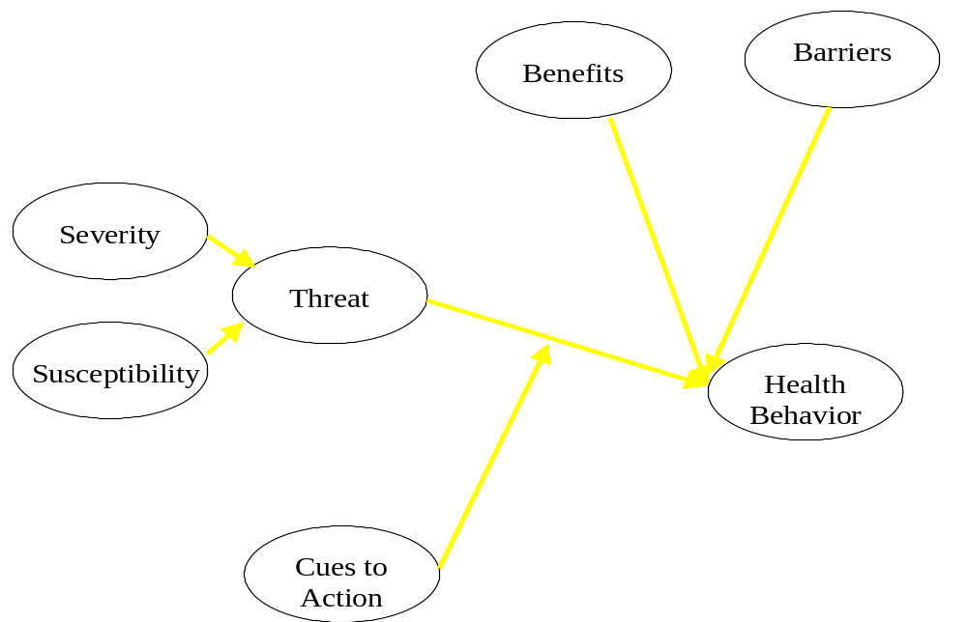
Health Belief Model
IRIET NAMAJA CAROLYNE CUU

Slide 33
Premise of the HBM
Individuals will take action to ward off, to screen for, or to control an ill health condition if:
  1) they regard themselves as susceptible to the condition
  2) they believe it to have potentially serious consequences
  3) they believe a course of action can reduce the susceptibility and seriousness
  4) they believe the costs of the action are outweighed by its benefits
IRIET NAMAJA CAROLYNE CUU

Slide 34
Components of the HBM
Perceived Susceptibility
  an individual’s perception of her or his risk of contracting a health condition
Perceived Severity
  an individual’s perception of the seriousness of a health condition if left untreated
Note: the combination of these is the perceived threat of the health condition (emotive response is fear)
IRIET NAMAJA CAROLYNE CUU

Slide 35
Components of the HBM
Perceived Benefits
  the perceived effectiveness of taking action to improve a health condition
Perceived Barriers
  the perceived impediments to taking action to improve a health condition
IRIET NAMAJA CAROLYNE CUU

Slide 36
Components of the HBM
Cues to Action
  Body or environmental events that trigger the HBM
IRIET NAMAJA CAROLYNE CUU

Slide 37
Thank You
IRIET NAMAJA CAROLYNE CUU

